Slide 1
CENTRE OF ENERGY STUDIES AND RESEARCH Devi Ahilya University, Indore
WEL COME

Slide 2
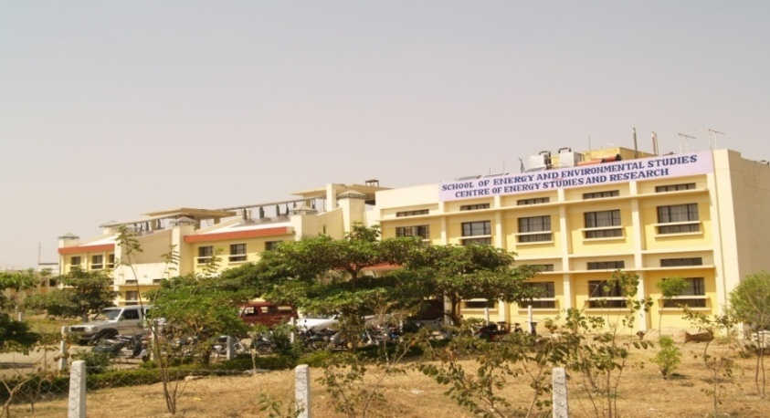
PROGRESS REPORT 2011-2012
CENTRE OF ENERGY STUDIES AND RSEARCH
Devi Ahilya University, Indore

Slide 3
COMPREHNESIVE PROGRESS REPORT 2006-2012
CENTRE OF ENERGY STUDIES AND RSEARCH
Devi Ahilya University, Indore

Slide 4
Honorable members of the Board
Prof. Raj Kamal
Vice-Chancellor
Devi Ahilya University,
Indore
Shri C.S. Chadda (Retd. I.A.S.)
Honorary Life Member, BOG
Shri S.R. Mohanti (I.A.S.)
Managing Director,
M.P. Urja Vikas Nigam, Bhopal
Mr. Asad Warsi
Director
ECO-PRO, Environmental Services
Indore
Shri B.K. Patel
Chief Engineer (In-charge)
M.P. Urja Vikas Nigam Ltd.,
Bhopal
Prof. Bhumesh Gupta
Director
Academic Staff College
DAVV, Indore
Prof. M.S. Sodha (F.N.A)
Founder Chairman, CESR
Luknow
Shri M.L. Bamboriya
Director
Ministry of New and Renewable Energy
Govt of India, New Delhi
Mr. S.L. Gangrade
Regional Manager
M.P. AGRO, Indore
Dr. S.P. Singh
Director, CESR and
Member Secretary, BOG
Centre of Energy Studies and Research, Indore

Slide 5
CENTRE OF ENERGY STUDIES AND RESEARCH
The Centre of Energy Studies and Research (CESR), an autonomous organization established by Devi Ahilya University, Indore and Madhya Pradesh Urja Vikas Nigam Ltd., Bhopal in December, 1989 to serve energy related academic, research and development needs in the state of Madhya Pradesh.
CESR registered as a society under the Society Registration act (1973), is academically a part of Devi Ahilya University, Indore under the faculty of Engineering Sciences and based at its Khandwa Road Campus of Devi Ahilya University, Indore.

Slide 6
ACTIVITIES CARRIED OUT (2011-2012)

Slide 7
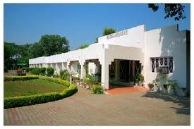
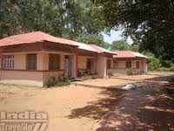
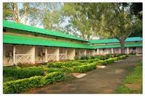
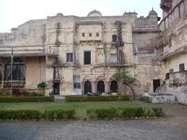
Energy Audit/Energy Conservation Projects
1. DETAILDED ENERGY AUDIT OF 54 UNITS OF M.P. TOURISM HOTLES IN MADHYA PRADESH
The Centre has carried out Detailed Energy Audit of 54 units of M.P. Tourism Hotels and the Report of the same have been submitted to the Madhya Pradesh Clean Development Mechanism Agency, Bhopal.

Slide 8
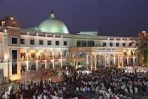
Energy Audit/Energy Conservation Projects
2. DETAILED ENERGY AUDIT OF INDORE COLLECTORATE BUILDING, INDORE
The Centre has carried out Detailed Energy Audit of Indore Collectorate Building and the report of the same has been submitted to the M.P. Urja Vikas Nigam, Bhopal for necessary action .

Slide 9
Energy Audit/Energy Conservation Projects
3. DETAILED ENERGY AUDIT OF M.P. URJA VIKAS NIGAM BUILDING, BHOPAL
As per Nigam’s requirement, we have conducted Detailed Energy Audit of head office building of M.P. Urja Vikas Nigam Bhopal. Report of the same is being prepared and will be submitted to the nigam soon.

Slide 10
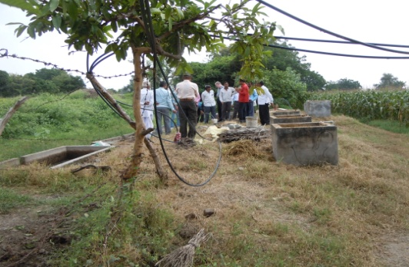
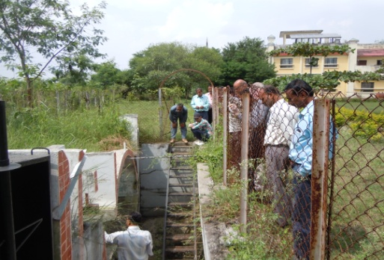
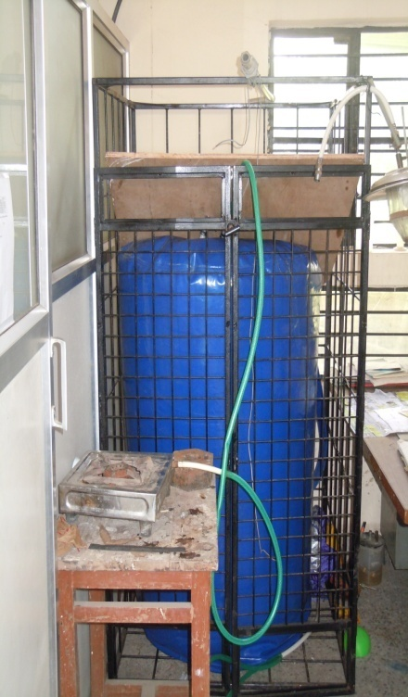
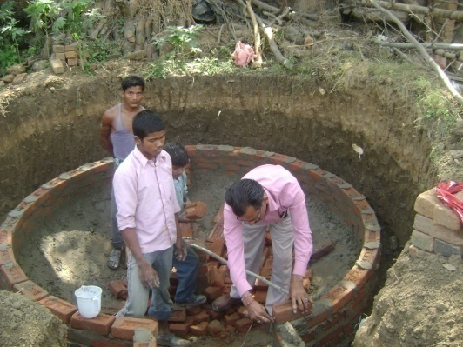
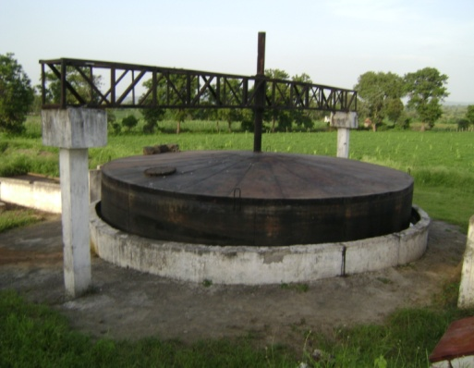
Activities under the Biogas Development and Training Centre (BDTC) (A sponsored programme of the ministry of new and renewable energy, Govt. of India, New Delhi)

Slide 11
Activities under the Biogas Development and Training Centre (BDTC)
Following activities has been carried out under the programme in M.P. and Chhatisgarh
S.No. | Name of the Activity | Number | Duration
1. | Construction cum Maintenance Training Programmes | 10 | 15 days
2. | Turn key Workers Training Programmes | 02 | 15 days
3. | Staff Training Programmes | 02 | 2 days
4. | User’s Training Programmes | 50 | 1 day
5. | Feed back survey of the constructed plants | 1000 | As assigned
6. | Biogas plants constructed during the CCM training programmes | 78 | -

Slide 12
Activities under the Biogas Development and Training Centre (BDTC)
ACTIVITIES OTHER THAN ASSIGNED WORK
1. A Detailed Project Report of 25 M³ biogas based power generation plant has been prepared for Param Pujya Asharam Bapu Goshala, Sheopur. The project has been sanctioned by the ministry under the subsidy scheme of the ministry.
2. Design, Drawing and Estimate of constructing of various size Biogas power generating Plants have been prepared and the same have been submitted to the M.P.Urja Vikas Nigam, Bhopal as per their requirement.
3. Third Party Verification work of Biogas Plants constructed by M.P AGRO is being carried out by the centre in 7 districts of M.P. Around 3300 have been surveyed and report to MPAGRO has been submitted.

Slide 13
Third Party Verification work of Solar Photovoltaic systems installed under the Remote village Electrification programme of the MNRE
Third Party Physical Verification work (on 100% basis) in 179 villages of 15 districts for the Solar Photovoltaic Systems installed by the M.P. Urja Vikas Nigam, Bhopal has been carried out by the centre. Status report has been submitted to the nigam.
S.No. | District | Number of Villages | No. of Solar Home Light Systems | No. of Street Light Systems | Total Systems Verified
1 | 15 | 179 | 15295 | 1351 | 16646

Slide 14
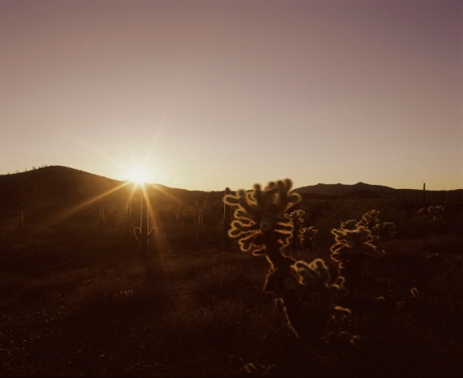
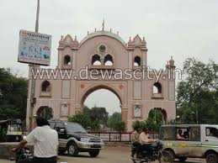
DPR preparation for Developing Dewas as Solar City
On request of the Municipal Corporation, Dewas, we have prepared a Detailed Project Report for Developing Dewas as Solar City. The report has been submitted to the DMC for further necessary action at their end.

Slide 15
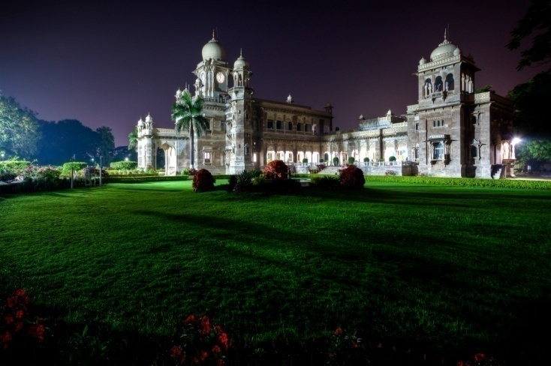
DPR preparation for 10kWp Solar Power Pack for Daly college, Indore
A Detailed Project Report for 10kWp Solar Power Pack have been prepared for Daly college, Indore. 50% subsidy for the project has been sanctioned and released by the ministry of New and Renewable Energy, New Delhi and the project has been commissioned in the College.

Slide 16
DPR preparation for Solar Power Pack for Ajmer Vidyut Vitran Nigam, Ajmer
A Detailed Project Report for 35kWp Solar Power Pack with storage batteries has been prepared for Ajmer Vidyat Vitran Nigam, Ajmer, Rajasthan. The Project has also been sanctioned by the Ministry of New and Renewable Energy, New Delhi.

Slide 17
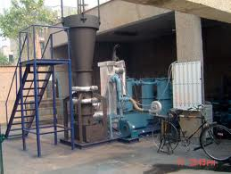
Research and Development Activities
A R&D Project entitled “Design Development of Horizontal Biomass Gasifier” has been sanctioned to the Centre by the Department of Science and Technology, Ministry of Science and Technology, New Delhi. Tenure of the project is 3 years and budget is 25.00 lacs.

Slide 18
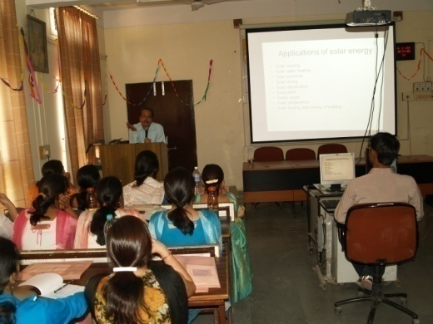
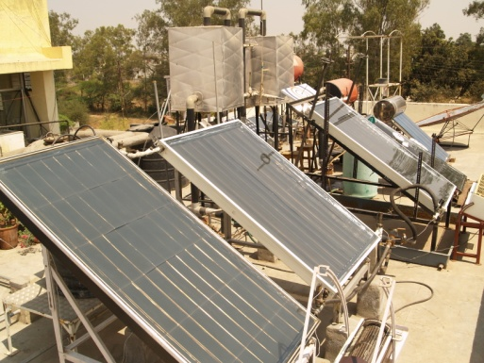
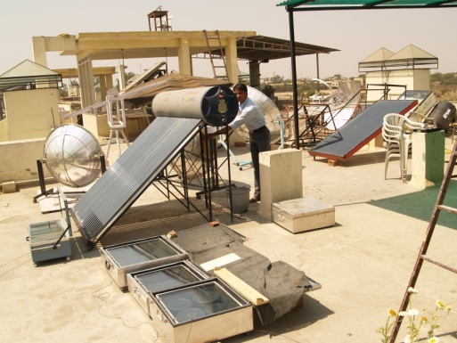
Educational and Training Programme
The MNRE had set-up an Energy Park (district level) at CESR. The Park is a unique facility for demonstration of different renewable energy gadgets. A number of students, visitors, faculties and general public visit the park and reply to their queries is given by the faculty and staff of the centre.

Slide 19
Testing Programme
The Centre is providing Third Party Test facilities to many agencies for the following:
Fuels (coal and bio-fuels)
Reflectivity and Emissivity Test of Paints and materials,
Gasifiers, Biomass Cook Stoves and
Energy Efficient Lighting systems.

Slide 20
Other Activities
The Centre is also supporting its sister concern, School of Energy and Environmental Studies in their academic programmes i.e. M. Tech. (Energy Mgmt.) , M. Tech. (Distance Education), M. Phil, (Energy and Environmental Mgmt.) and Ph.D. Programme.

Slide 21
Future Objectives
The centre aims at main thrust on the following
Areas for fund generation:
Energy Audit and Energy Conservation Projects in Industries, Commercial and Residential Building sectors.
Third Party Verification for various schemes implemented by the different agencies.
DPR preparation for Biogas based Power Generation projects.
Testing of Fuels, Water, Solar Energy Devices, Energy Efficient Lighting systems for the purpose of third party verification.

Slide 22
Limitations
Due to short funding support of the nigam, the Centre is facing hardship and couldn't fill vacant positions and hence restricts to achieve its set objectives. Present position of the staff is as under:
S.No. | Position | Status
1 | Director | As per BOG’s decision, Head, School of Energy is also acting as Director of CESR
2 | Dy. Director -I | Vacant
3 | Dy. Director - II | Vacant
4 | Research Assistants (4 Positions) | Filled 2 Vacant 2

Slide 23
THANK YOU

